Slide 1

GENERATIVE AI FINAL PROJECT PRESENTATION
HTML & SVG Visual Abstract built with Claude SONNET 4:
Life Satisfaction of People Living with Hepatitis B in Senegal
Presenter: Kevine Tiogouo TEZEMENE Date: 29/06/2025

Slide 2
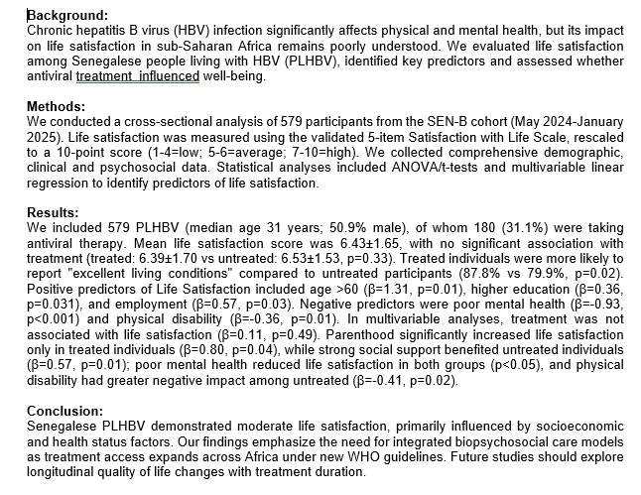
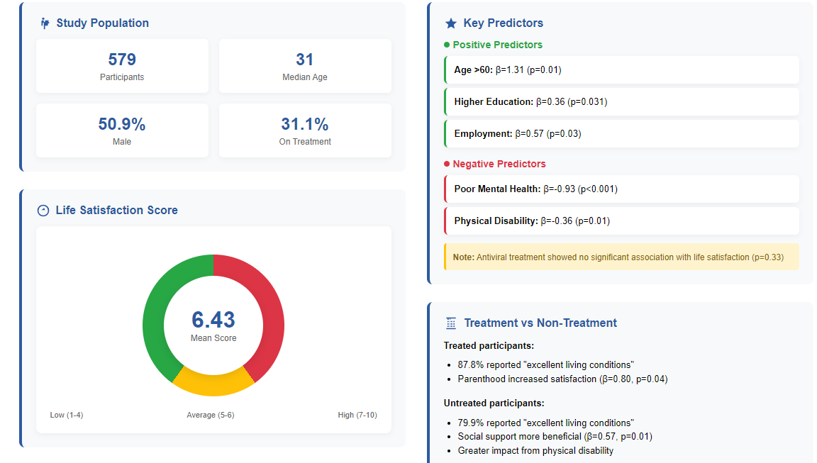
Problem / Opportunity
Dense 350‑word abstract is slow to digest in staff meetings & social feeds.
Designing PowerPoint/Posters manually can take hours.
Need a LinkedIn-ready asset before peer review to showcase.

Slide 3
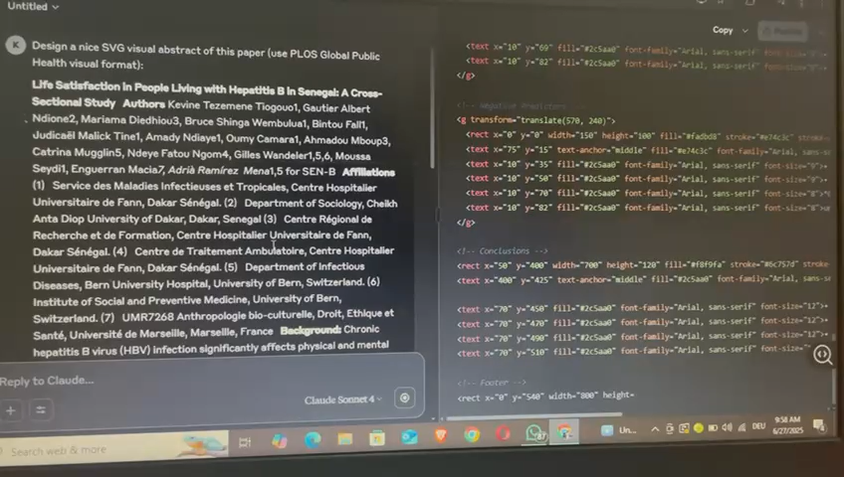
Solution & Workflow 1/3
Prompt Claude Sonnet 4: “Design an HTML visual abstract for this paper…”, pasted the abstract
Iterate in chat → trim text, reorder sections.
Repeat in new chat for SVG variant.
Compare outputs → pick HTML for cleaner layout.
Download as HTML.

Slide 4


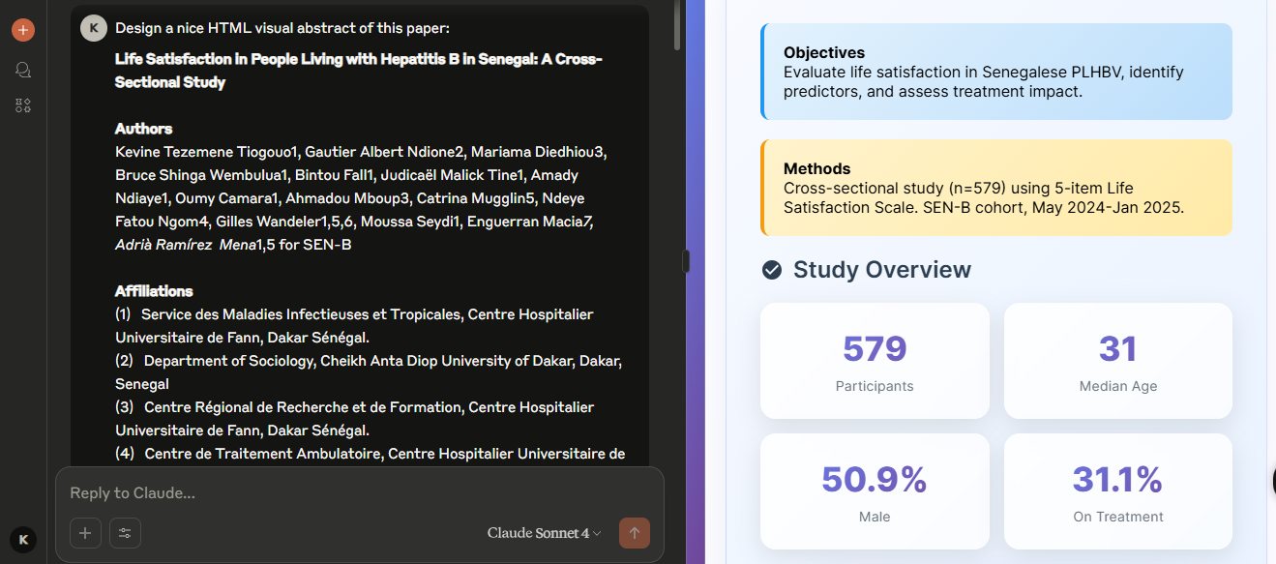
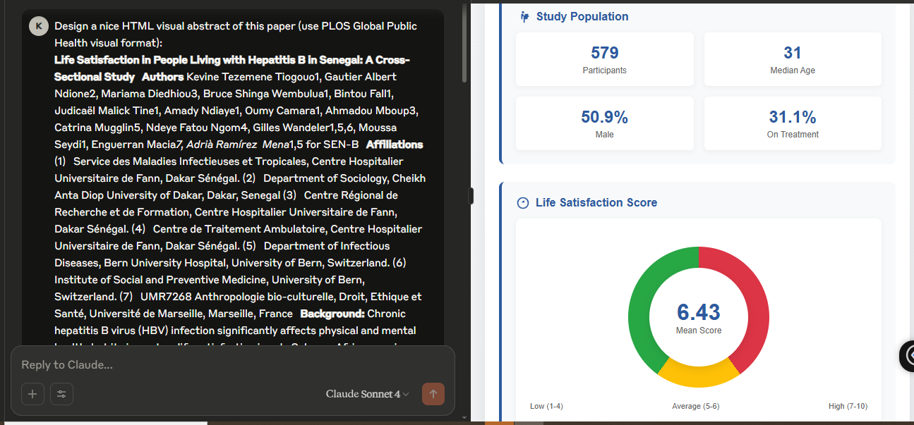
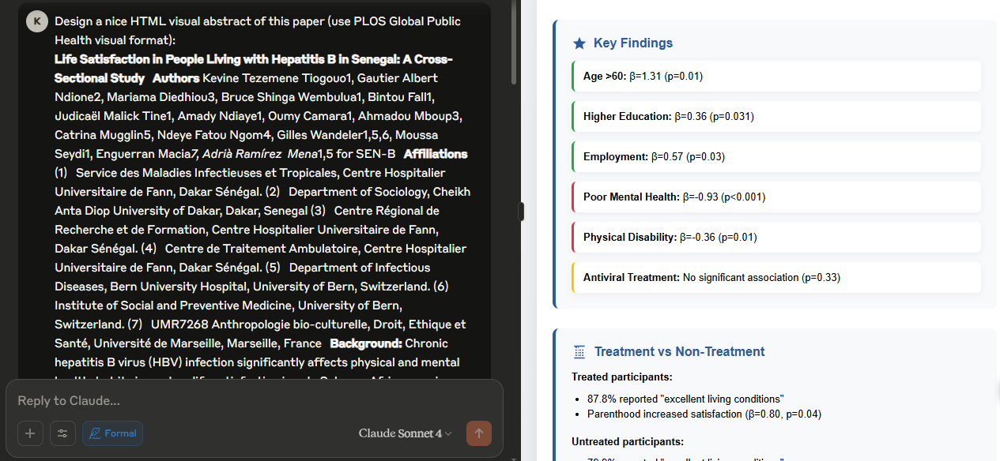
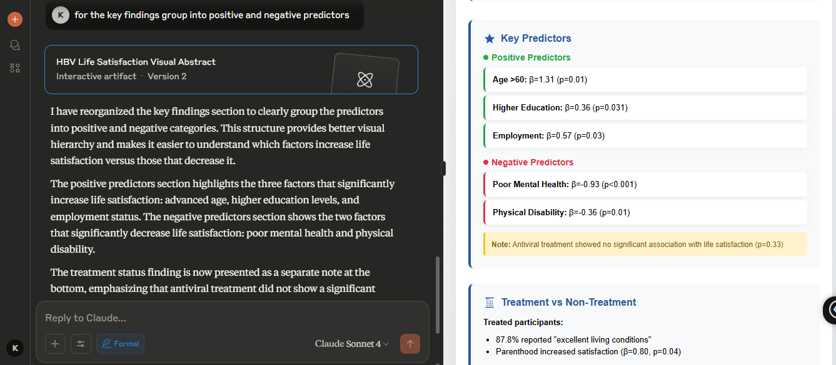
HTML Visual Abstract Prompts 2/3

Slide 5
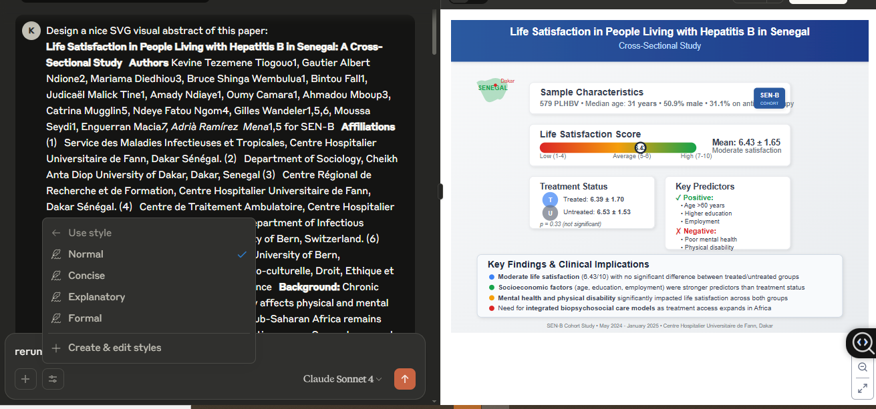
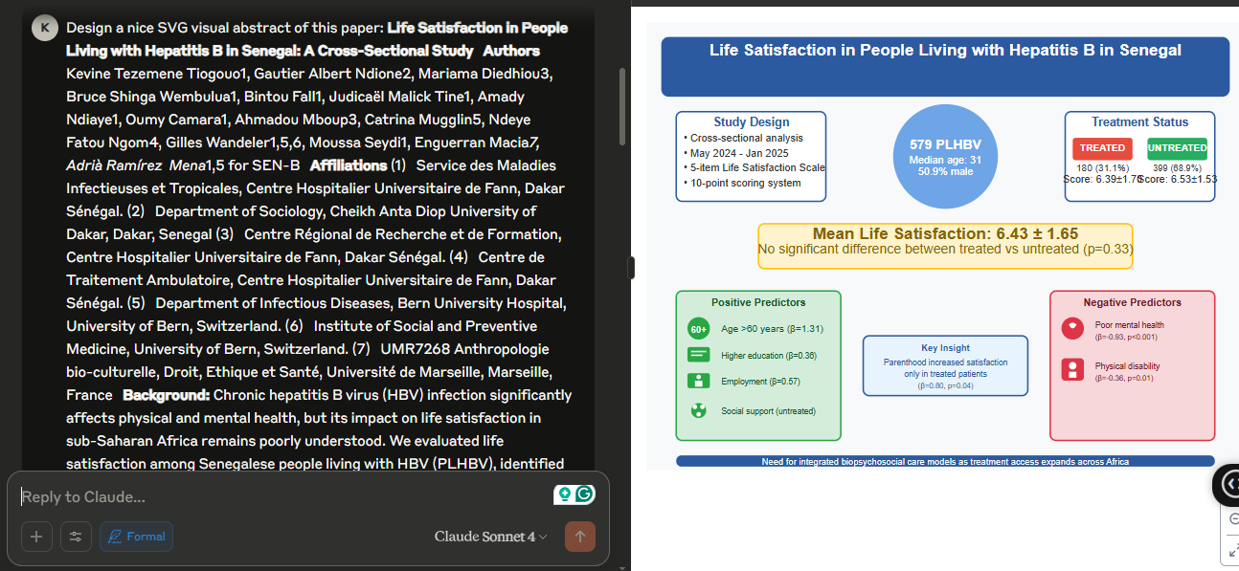
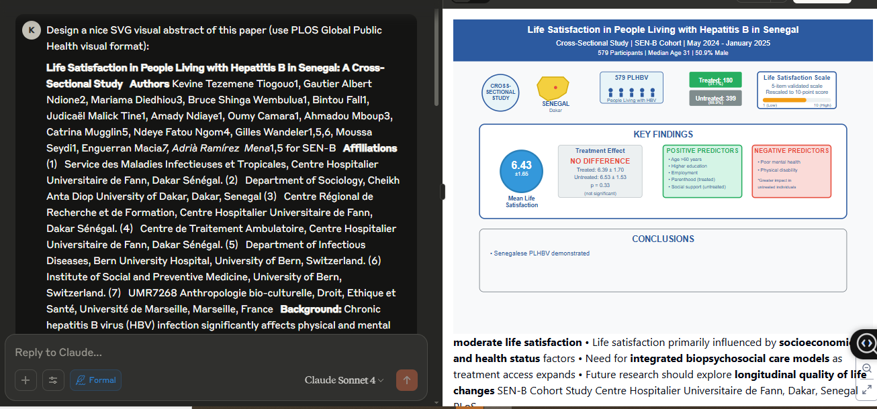
SVG Visual Abstract Prompts 3/3

Slide 6
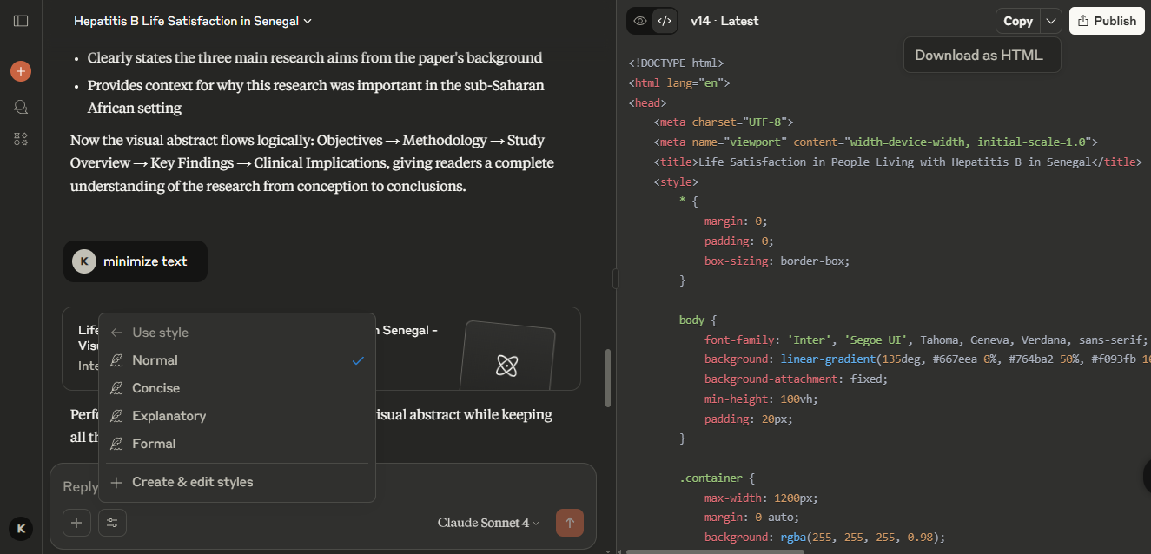
Key AI Features & Tools
Claude Sonnet 4 code‑block output → valid HTML/SVG instantly.
Prompt template enforces grid, colour palette, minimal text.
Live browser preview for rapid layout checks.
Possible to change styles
Download file as HTML, copy code, publish/copy link.
Link: https://claude.ai/public/artifacts/aecdfde2-bceb-4918-8b89-ec238629c32c

Slide 7
Claude AI Limitations
Manual trimming is still required.
Needed follow‑up prompts for correct section order, layout, and text format
SVG layout felt crowded vs HTML version.
HTML with Claude normal style, more textual than formal style
Not possible to modify code
Human QA is still needed for colour contrast & readability.

Slide 8
Opportunities for Improvement
Smarter layout & brand styling via style‑guide ingestion.
Embedded editable code editor for live tweaks without re‑prompting.
Reduce the cost of paid plans to benefit from more AI features

Slide 9
Reflection & Next Steps
Claude AI cuts design time from hours to minutes.
Still requires a human eye for aesthetics and clarity.
HTML has better visual than SVG
Plan: upload my visual abstract to my AI portfolio, showcase my findings on LinkedIn, apply workflow to more abstracts

Slide 10
Thanks for Listening

